Slide 1

Project title : NUTI
Gaurav Dubey 2000290120065
Pushkar Saraswat 2100290129006
Hardik Soni 2000290120068

Slide 2

Introduction
Business activities have become more convenient and efficient as technology has advanced, and the world has shrunk to the size of a village. People all over the world can now connect easily and quickly thanks to the introduction of smartphones. A buyer in the United States can review and buy an item from China and have it delivered to his door. Similarly, a seller can advertise and sell a product to a large number of customers worldwide without having to travel. Thus, e-commerce refers to the ability to conduct business transactions without the seller and buyer coming into physical contact.
Businesses around the world are now faced with the choice of adapting to ever-changing technological advancements or becoming obsolete by remaining rooted in brick-and-mortar tradition. Enterprises are now struggling to compete with online shopping companies like Amazon, which rely entirely on e-commerce. With this project we are going to provide solution to various retailers and shopkeepers by making easy for them to attract the customers who live in the nearby locations to purchase the items they are looking for in the lowest price and from the nearest location.
In this project, we will provide services to the customers based on choice of item they want to purchase. Our project is all about making a website to satisfy the customers with their demands in the least amount and within the least distance (by identifying shortest possible path to reach the place).

Slide 3
PROBLEM STATEMENT
The motive of this project is to basically find any thing legally sold in the market example, mouse, bottle, pen drive, laptop and many more items. The searching of these items will be based on keywords/ Google scanner to scan the image of the product. The output of the website will be all the nearby locations selling those items/products. The results will be sorted based on the distance and prices. Then, the customer may either visit the shop to purchase the product.

Slide 4
OBJECTIVE
This website will be one stop solution for the customers as it will :
Compare the prices of the item searched by the customers in an efficient manner
Provide a choice to the customer to either search the item through company name, product name or via image through google scanner.
Help the retailers and shopkeepers to expand their network by connecting to the local customers with the help of technology
Satisfy the customer with the product availability in least price and from the nearest location.

Slide 5
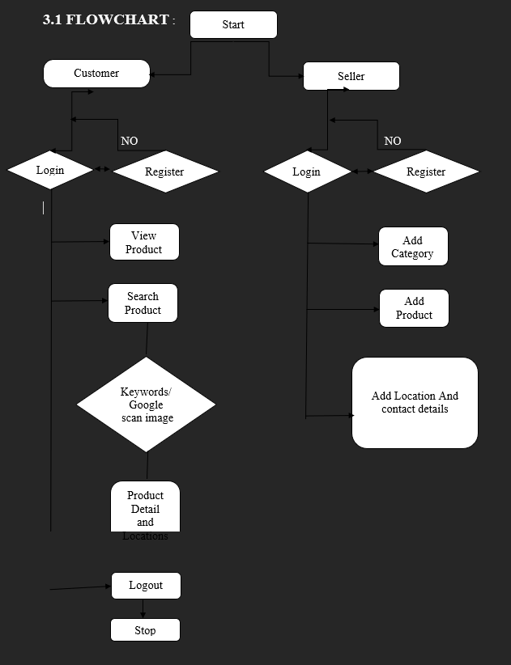

Slide 6
TECHNOLOGY USED
React:
React (also known as React.js or ReactJS) is a free and open-source front-end JavaScript library for building user interfaces based on UI components. It is maintained by Meta (formerly Facebook) and a community of individual developers and companies.React can be used as a base in the development of single-page, mobile, or server-rendered applications with frameworks like Next.js. However, React is only concerned with state management and rendering that state to the DOM, so creating React applications usually requires the use of additional libraries for routing, as well as certain client-side functionality.
Javascript:
JavaScript is a dynamic programming language that's used for web development, in web applications, for game development, and lots more. It allows you to implement dynamic features on web pages that cannot be done with only HTML and CSS.
Many browsers use JavaScript as a scripting language for doing dynamic things on the web. Any time you see a click-to-show dropdown menu, extra content added to a page, and dynamically changing element colors on a page, to name a few features, you're seeing the effects of JavaScript.

Slide 7
There are two ways to use JavaScript in an HTML file. The first one involves embedding all the JavaScript code in the HTML code, while the second method makes use of a separate JavaScript file that’s called from within a Script element, i.e., enclosed by Script tags. JavaScript files are identified by the .js extension. Although JavaScript is mostly used to interact with HTML objects, it can also be made to interact with other non-HTML objects such as browser plugins, CSS (Cascading Style Sheets) properties, the current date, or the browser itself. To write JavaScript code, all you need is a basic text editor like Notepad in Windows, Gimp in Linux, or BBEdit. Some text editors, like BBEdit feature syntax highlighting for JavaScript. This will allow you easily identify elements of JavaScript code. The latest versions of Internet Explorer, Firefox, and Opera all support JavaScript.
MongoDB:
MongoDB is an open-source document-oriented database that is designed to store a large scale of data and also allows you to work with that data very efficiently. It is categorized under the NoSQL (Not only SQL) database because the storage and retrieval of data in the MongoDB are not in the form of tables.
The MongoDB database is developed and managed by MongoDB.Inc under SSPL(Server Side Public License) and initially released in February 2009. It also provides official driver support for all the popular languages like C, C++, C#, and .Net, Go, Java, Node.js, Perl, PHP, Python, Motor, Ruby, Scala, Swift, Mongoid. So, that you can create an application using any of these languages. Nowadays there are so many companies that used MongoDB like Facebook, Nokia, eBay, Adobe, Google, etc. to store their large amount of data.

Slide 8
Node.js:
Node.js (Node) is an open source development platform for executing JavaScript code server-side. Node is useful for developing applications that require a persistent connection from the browser to the server and is often used for real-time applications such as chat, news feeds and web push notifications.
Node.js is intended to run on a dedicated HTTP server and to employ a single thread with one process at a time. Node.js applications are event-based and run asynchronously. Code built on the Node platform does not follow the traditional model of receive, process, send, wait, receive. Instead, Node processes incoming requests in a constant event stack and sends small requests one after the other without waiting for responses.
This is a shift away from mainstream models that run larger, more complex processes and run several threads concurrently, with each thread waiting for its appropriate response before moving on.

Slide 9
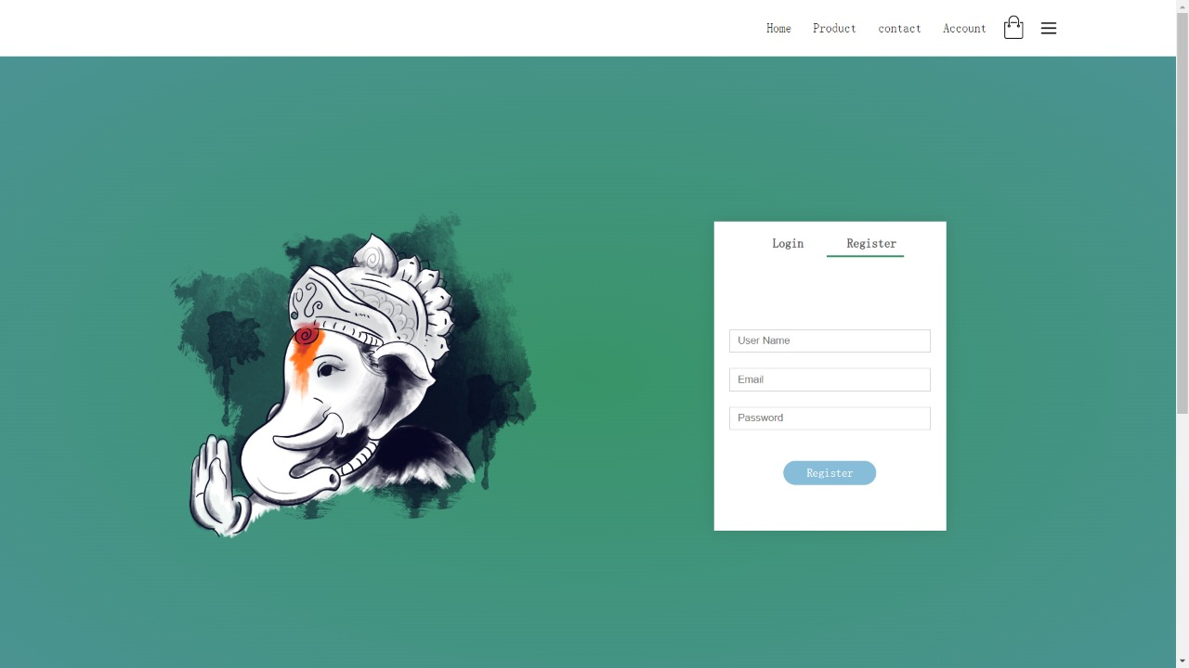

Results (achieved till now)

Slide 10
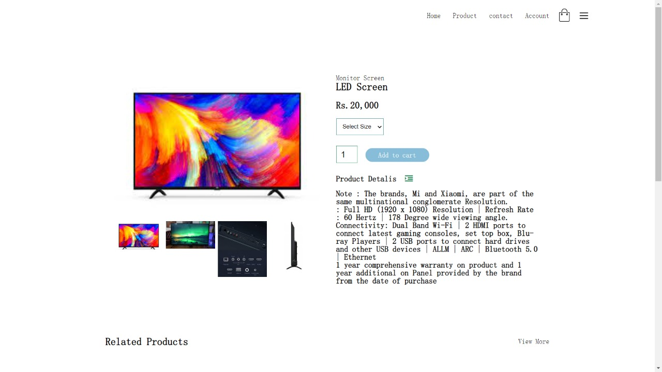
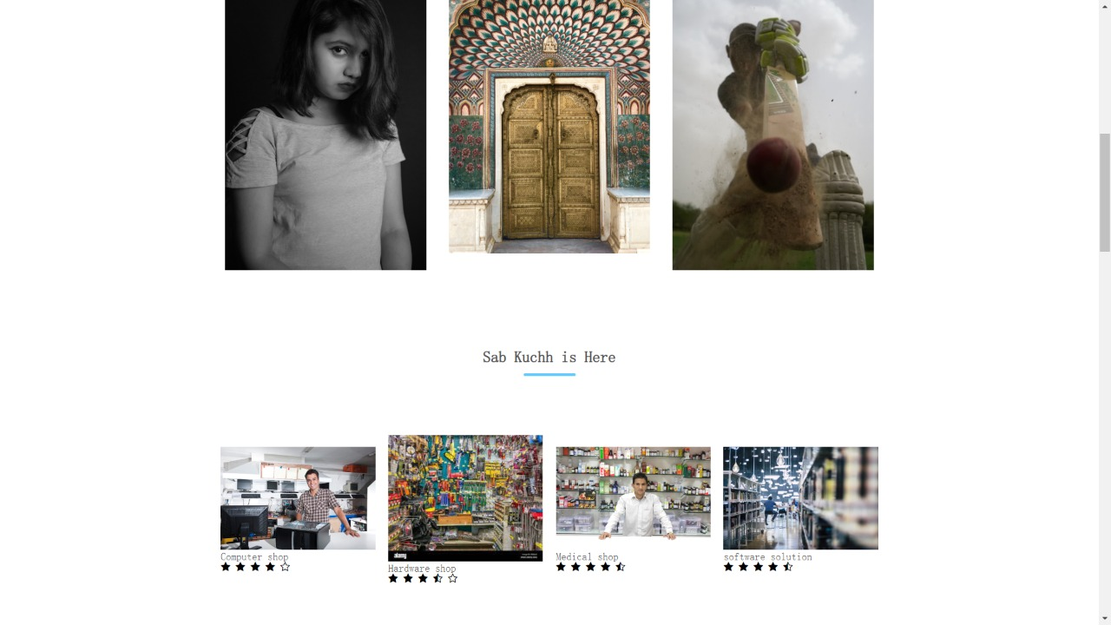
CONTD.
PRODUCT DESCRIPTION PAGE
PRODUCT PAGE

Slide 11
CONCLUSION
E-Commerce is a boon for any country- if given right impetus and good environmental framework to prosper can significantly lead to country’s progress and development. Through our project we have tried to help the local shopkeepers to establish a connection with the technology and increase their income by letting the customer know about the product availability at their shops at affordable price.

Slide 12
FUTURE SCOPE
After discussion with the team and with our guide, we can consider the scope of this project as follows :
It will give an Opportunity to Retailers/ shopkeepers to be recognized and their product visibility will increase in a particular area.
Customers will have more faith over the nearby shopkeepers and will be satisfied by relying on their products.

Slide 13
REFERENCES
Awais Muhammad and Samin Tanzila (2012), “Advanced SWOT Analysis of ECommerce”, IJCSI International Journal of Computer science Issues, Vol 9,Issue 2,No 2,pp. 569-574
Blasio,G.,D. (2008), “Urban–Rural Differences in Internet Usage, e-Commerce, and eBanking: Evidence from Italy”, Growth and Change, 39.2 , pp. 341–367
Chanana Nisha and Goele Sangeeta, “Future of e-commerce in India”, International Journal of Computing & Business Research, ISSN (Online): 2229-6166
Chou,D.,C. and Chou,A.,Y. (2000), “The E-Commerce Revolution, A Guide to the Internet Revolution in Banking” information systems management,pp.51-57
D’silva,B., D’Silva,S., and Bhuptani,R.,S.,K.(2010), “Behavioral Aspect of Teenagers Towards Internet Banking: An empirical study”, Indian journal of marketing, 40.10, pp.44-53
Dutta and Dutta (2009) “A Study on Customer Perception towards HDFC Limited” International Journal of Management Sciences and Business Research Volume 2, Issue 4- ISSN (2226-8235)

